Slide 1
NoSQL Book Figures
Dan McCreary
Distinguished Engineer
Notes:
Hi – my name is Dan McCreary. I am a Distinguished Engineer working in the Advanced Technology Collaborative. I am leading the graph technologies initiative within the Advanced Technology Collaborative. Our goal is to build a collaborative community the use graph technology to lower the cost of healthcare and give Optum a competitive advantage in the marketplace.

Slide 2
Outline
The backstory – selection bias in databases
Ten challenges in Healthcare today
How graph technologies can help
Three metaphors to explain graphs to managers
The challenge: help us solve wicked healthcare problems

Slide 3
About Optum
Our Mission: To help people live healthier lives and to help make the health system work better for everyone.
Part of United Health Group ($200B in Revenue in 2017)
270,000 employees and growing…
Over 42,000 IT employees
Over $1B/year in data analytics
Over 3,000 people involved in analytics and data science

Slide 4

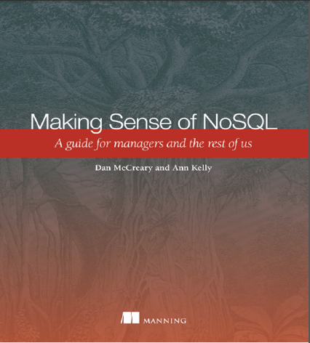
Hello, my name is
Dan
Distinguished Engineer in AI and Graph Technologies
Work in Advanced Technology Collaboration
Co-founder of "NoSQL Now!" conference
Author of "Making Sense of NoSQL" (w. Ann Kelly)
15+ years of working with NoSQL
Background in solution architecture, metadata management, NLP, semantics, text analytics and knowledge representation for AI
Interested in cognitive bia in the database selection process
dan.mccreary@optum.com
Notes:
My background is a solution architect. I have spent most of the last 20 years understanding how to objectively match business problems to the appropriate technologies. My focus has been on the fast-evolving area of NoSQL databases. I have also had a strong interest in AI, semantics, natural language process and search. I have been working on challenges problems in C360 and Benefit Search for over four years within Optum.

Slide 5
The World is “Not Only SQL” (a.k.a. NoSQL)
Relational
Analytical (OLAP)
Key-Value
key
value
key
value
key
value
key
value
Column-Family
Graph
Document
See Chapter 1: https://www.manning.com/books/making-sense-of-nosql
5
Notes:
OK, now lets take a step back and take a more structure look at where these tools fit into our business processes at Optum.
There are six main database architecture patterns we use when we think of a business problem.
Relational or row-stores
Analytical or OLAP
Key-Value stores – one of the simplest but most extensible data architectures
Column-family stores
Graph stores
and Document stores
Graph is just one of these six. Graph stores are often most closely related to document stores. Both Graph and document stores have the ability for new data to be added to structures without needing to remodel the data. We call these systems schema-free or schema agnostic. They are a key driver for highly agile systems.
Your systems may often draw on two or more of these systems. Databases that support multiple data models are called multi-model databases. They prevent us from having to store the same data over in multiple systems for transactions, search and analytics. Multi-modal systems that integrate graph technologies are also an emerging trend.

Slide 6
The World is “Not Only SQL” (a.k.a. NoSQL)
Relational
Analytical (OLAP)
Key-Value
key
value
key
value
key
value
key
value
Column-Family
Graph
Document
See Chapter 1: https://www.manning.com/books/making-sense-of-nosql
6
Notes:
OK, now lets take a step back and take a more structure look at where these tools fit into our business processes at Optum.
There are six main database architecture patterns we use when we think of a business problem.
Relational or row-stores
Analytical or OLAP
Key-Value stores – one of the simplest but most extensible data architectures
Column-family stores
Graph stores
and Document stores
Graph is just one of these six. Graph stores are often most closely related to document stores. Both Graph and document stores have the ability for new data to be added to structures without needing to remodel the data. We call these systems schema-free or schema agnostic. They are a key driver for highly agile systems.
Your systems may often draw on two or more of these systems. Databases that support multiple data models are called multi-model databases. They prevent us from having to store the same data over in multiple systems for transactions, search and analytics. Multi-modal systems that integrate graph technologies are also an emerging trend.

Slide 7

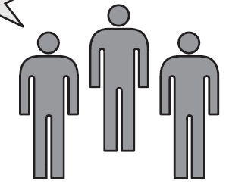
Role of the Solution Architect
Help!
Relational
Analytical (OLAP)
Key-Value
k
v
k
v
k
v
k
v
Column-Family
Graph
Document
Business Unit
Sally Solutions
Title: Solution Architect
Non-bias matching of business problem to the right data architecture before we begin looking at a specific products.
See appendix for a list of common selection bias.
Notes:
Lets now take a look at the role of the solutions architect is to select the RIGHT data architecture based on the requirements of the business unit. Let’s call our main character Sally Solutions. When a business unit comes to Sally her job is to understand their high-level requirements and match the problem at hand to the right database architecture. Ideally she would do this before anyone starts to look at products.
The entire point of this session is to make sure we all understand when graph databases and graph technologies should be considered an option. Graph need to be one of the architectures considered.

Slide 8
Two Ways of Solving Business Problems
Single Perspective
Diverse Perspectives
Relational
Relational
Relational
Relational
Analytical
Key-Value
Relational
Relational
Relational
Column-Family
Graph
Document
Tradeoffs
Relational
Relational
Relational
Relational
Multimodal
Graph
Which perspective will maximize the probability of a low-cost, scalable competitive solution in the marketplace?
Do we value diversity of opinions as a core value of our organization? Are we biased? What about standards?
There is no single right answer to this question; only tradeoffs.
Notes:
Although Relational databases still faithfully serve many of our needs today, it would be foolish to think that all our future problems could also be solved with a narrow set of database technologies.
Organization that have a diverse set of options will be more empowered to solve new business challenges. Graph, and multi-modal databases are something we would like everyone to be aware of. We also want to understand when our selection bias might now be in alignment with the our organization strategy and the needs of our customers.
Remember – there will rarely be a single technology that will fit the needs of a complex business problem. There are however methods to help us compare the tradeoffs of different architectures. Let’s take a look at one of the most common ways to help us find the right fit for a business problem.

Slide 9
Architectural Tradeoff and Analysis Method (ATAM)
Business
Drivers
Quality
Attributes
User
Stories
Analysis
Architecture Plan
Architectural
Approaches
Architectural
Decisions
Tradeoffs
Impacts
Sensitivity
Points
Non-Risks
Risk Themes
Distilled info
Risks
The ATAM process defined by CMU's Software Engineering Institute (SEI)
Notes:
Let me introduce you to the Architectural Tradeoff and Analysis Method or ATAM method.
ATAM is a proven structured process developed by Carnegie’ Mellon's Software Engineering Institute to objectively analyze the tradeoffs when selecting an architecture or database. The process has two main paths:
Helps is understand the architecturally significant requirements that help us drive the selection process
The second path helps us understand what possible options we can take. We want Graph databases are one of the Architectural Approaches. This is the center box in the 2nd row.

Slide 10
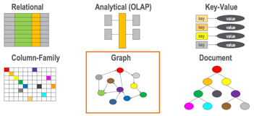
Graph Databases as an Architectural Approach
Business
Drivers
Quality
Attributes
User
Stories
Analysis
Architecture Plan
Architectural
Decisions
Tradeoffs
Impacts
Sensitivity
Points
Non-Risks
Risk Themes
Distilled info
Risks
We want all appropriate architecture options to be considered by Optum/UHC Solution Architects
Notes:
So how do the six options fit in? We want graph databases to be consider fairly along with existing legacy systems. Once you have a list of the options you can compare how hard it will be do do your critical user stores for each architecture. If a process is really easy in a graph but more difficult in a relational database you can see this in your analysis.
Although we will not go into the fine details of doing this analysis, called utility tree analysis, we want you to be aware of the process and be willing to bring in experts to help you use this process to objectively know when graph technologies should be used.

Slide 11
Ten Challenges in Healthcare
Data silos
Highly variable data
Diverse data formats
Terminology
Intercompany trust
Data privacy
Complex rules
Chatbots and search
Machine learning and explainability
Scale
What problems can graphs help us solve?

Slide 12
From Data Silos to an Enterprise Knowledge Graph
Claims
Clinical
Genomics
Providers
Rx
IoT
Today data is in isolated silos
No clear mapping between datasets
We need an integrated enterprise healthcare graph
All data merged into a single graph
Advanced entity resolution using AI/ML

Slide 13
Graphs work well on high-variability data
Low Variability
High Variability
General Ledger (GL)
Claims
Drug Interactions
Clinical Data
Invoice
Benefit Plans
360 Applications
Star Rating
Shopping Cart
Providers
Genomics
Data Hubs
Most business systems fit somewhere on a spectrum of data variability
Highly regular systems, like a GL have low variability
Variability tends to grow over time as exceptions are introduced to a system
Few real world systems can accurately predict future variability

Slide 14
Search and Chatbots
Member Chat>
We are expecting a new baby? What is my coverage?
Here is a link to your maternity coverage.
<Chabot answer
Question: How do we associate “new baby” with “maternity coverage?

Slide 15
Benefits Plan Ontology
Reusable, adjustable ontology models to classify benefit documents and expand keywords for
semantic search?
Infant
Baby
Mental Health
Child
Physician Visits
Maternity Care
Benefit Plan
Surgical Procedures
Preventive Care
Notes:
At the beginning of this class we talked about how Google and other search companies use knowledge graphs to help search. We also want to show how this same technology is being investigated to improve the search quality of Benefit Plan searching.
Our challenge is that our users use different words to search for answers. For example, they might ask “We are planning to have a new baby. What is covered by my plan?”. But the word “Baby” is not listed in the Maternity Care benefit section. So the search would return no results.
In an effort to overcome this obstacle, a solution that uses reusable, adjustable ontology models to classify benefit documents can be used. This leads to a smart search experience through the promotion of semantic search, allowing users to search using everyday language and receive the appropriate information.
Our ontologies allow us to harmonize disparate data sources and through the classification process we can extract facts and relationships in documents.

Slide 16
The Value of Connected Data
Claims
Providers
Benefits
Clinical
Genetics
How are genes tied to ICD-10 codes?
Notes:
Lets take a look at how valuable this new world of connected data might become. Here we see a set of five silos of applications. For example we might have a database of claims. Another system might store a list of all the healthcare providers. A third database might contain a list of all our benefit plans. We also might have access to clinical data stored directly in an EMR. An now we add an new database – all the genes that have been sequenced by one of our members.
How do we tie all of these things together? What if we wanted a way to recommend what genetic test are associated with each member?

Slide 17
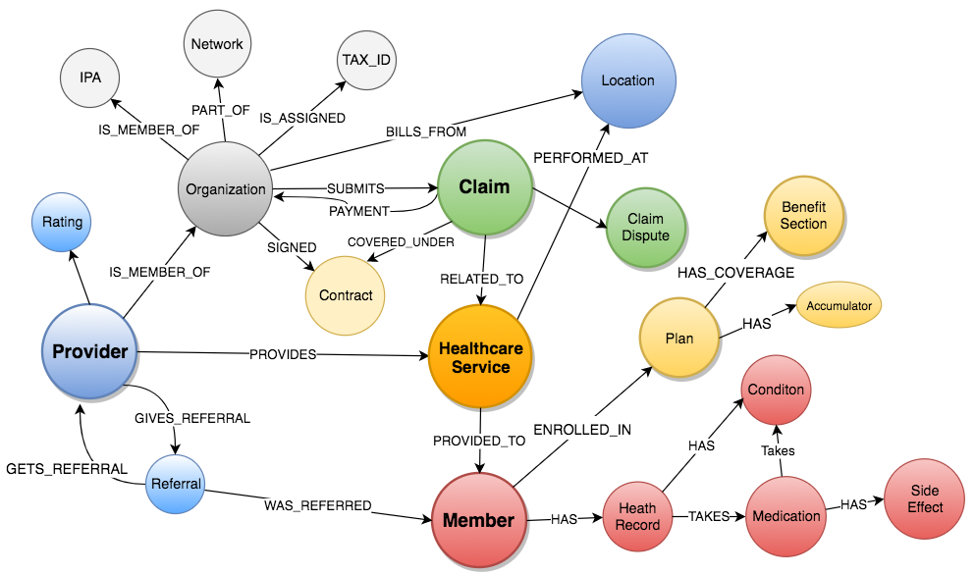
Healthcare Network Graph
Notes:
Healthcare data is not like a general leger data. There are many complex relationships between our datasets. Especially when we start to look at clinical data. We think the best way to understand this data is to load it into a graph database.

Slide 18
The Enterprise Knowledge Graph For Healthcare
Individual A’s
Healthcare Record
Individual B
Role-based access control
Open Linked Data Reference Data – UMLS (Public)
Similar to a “Data Lake” but where all the data is connected and secured by role-based access control
All queries can access the Open Public Data like the UMLS graph
Graph queries can access Member Population A or B but not both
Notes:
Now lets think about what an Enterprise Knowledge Graph for Healthcare might look like. Lets start out with our concept of an Individual Healthcare Record (IHR) in the form of a graph. Each person will have a graph that contains their Individual Healthcare Record. Each individual record might have some numeric code in it such as an ICD-10 code. These codes will link to another graph that includes reference data about that code. Note that IHR data points to reference data, but reference data never has knowledge of a IHR. Note that each IHR has complex role-based access.

Slide 19

Graphs Promote Cross-domain Solutions
What if we could link these datasets?
We want our business stakeholders to think about new business values by being able to link datasets from across cross multiple data domains
What new value could we add if we added a new dataset?
Can we harvest data from call logs to find frequent callers and suggest the next best action?
Can we leverage public data sets?
Example: if a member does not drive car we calculate nearness to a bus route to provider data?
Notes:
Graph technologies require us to change the way we approach problem solving. In the past, adding new data to any relational databases was expensive. Putting two relational databases in a new database and connecting all the data was also a daunting task. What we are asking our thought leaders to do is re-think their problems in terms of an integrated graph solution. What public datasets could we add to help our our call center experience?

Slide 20

Explainable AI Models are Graphs
Today
Task
Why did you do that?
Why not something else?
When do you succeed?
When do you fail?
When can I trust you?
How to I correct and error?
Training
Data
Machine
Learning
Process
Learned
Function
Decision or Recommendation
Explainable AI
Task
I understand why
I understand why not
I know when you succeed
I know when you fail
I know when to trust you
I know why you erred
Training
Data
New
Machine
Learning
Process
Explanation
Interface
Explainable Model
https://www.darpa.mil/program/explainable-artificial-intelligence
Notes:
Explainable AI is a key
https://www.darpa.mil/program/explainable-artificial-intelligence

Slide 21
Model-based Machine Learning
Many Algorithms
Few Algorithms
Flat Data
Many Algorithms
Specific Solution
Graph Data
Hidden Assumptions
Assumptions in Graph Structure
One Algorithm
Universal Inference
General Solution
Model-based machine learning requires the user to create a model of the world in the form of a graph. This model encodes the assumptions you make such as how a change on one variable changes another variable (causal relationships).
Model-based machine learning allows fewer algorithms and universal inference
http://www.mbmlbook.com

Slide 22
Model-based Machine Learning
Many Algorithms
Few Algorithms
Flat Data
Many Algorithms
Specific Solution
Graph Data
Hidden Assumptions
Assumptions in Graph Structure
One Algorithm
Universal Inference
General Solution
Model-based machine learning requires the user to create a model of the world in the form of a graph. This model encodes the assumptions you make such as how a change on one variable changes another variable (causal relationships).
Model-based machine learning allows fewer algorithms and universal inference
http://www.mbmlbook.com

Slide 23
Three Useful Metaphors
The Neighborhood Walk
The Knowledge Triangle
The Open World Assumption
How do we explain graph to managers?

Slide 24

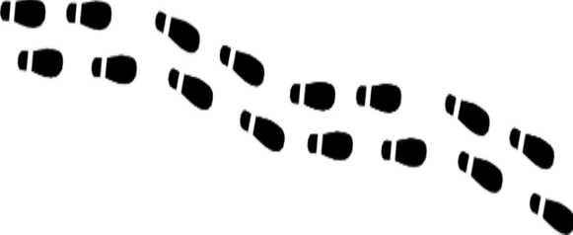
How do you get to your neighbor’s house?
You walk out your door and over to the house
Your houses are “Adjacent” so getting there is a direct “hop”
You don’t need to consult anyone else about how to get to a neighbor’s house because you have the right pointer
Notes:
Sometimes the best way to understand how graph databases are different is using a metaphor. We call this metaphor the “Neighbor Walk” metaphor. It has proven very helpful for people that are trying to understand the performance differences between relational joins and a graph traversal.
Let’s say you want to walk out your front door and over to your neighbor’s house. You open the door, point you body to the neighbor’s house and walk over there. Pretty simple. Since your houses are adjacent this is the logical way to do it.

Slide 25
Your Logical Graph Model
LIVES_NEXT_TO
Dan
Ann
If two physical items are related, they have a relationships arch between them and we model it like the above
We build a “logical” data model that has this link
In a native graph, the vertexes are loaded into memory and then the physical memory addresses of each link is also reflected in each of the nodes
Notes:
Here is the graph “logical model” for this. You might have a vertex for your house, a relationships called LIVES_NEXT_TO as a pre-calculated relationship to your neighbor’s house.

Slide 26


Relational Database Use Indexes
Central
Index
Search: 123 Main St.
You must walk to a central index system
The index system does a “search” given the house’s address
The index system will tell you how to get to your neighbors house
Notes:
Here are the steps that are reflective of how a relational databases does joins
Walk out the door
Walk downtown to the DMV where they have a service that tells you how to get to your neighbor’s house
When you get to the DMV you take a number
When your number comes up you get called by a search agent
You give your neighbors name to the DMV search agent
The search agent at the DMV has a list of all the people in your town sorted by their address (called the index). They search the list (using a binary search algorithm) and they finally give you the GPS coordinates of your neighbor’s house.
You take these GPS coordinates, enter them them into your GPS tracker and follow the directions to Ann’s house.
Now granted the metaphor is not perfect. The speedup really depends on how many rows each table has. However, this metaphore helps you remember that sometimes directly addressing a memory location that is pre-calculated for you at load time can sometimes be three orders of magnitude faster than searching for something every time you need to access it. RDBMS systems try to minimize this search time by doing clever things like caching. However the more data you have the longer the searches take. Direct memory access will always be faster than doing a search!
Now lets also look at some different architectures than a single node graph.

Slide 27
Graphs and the “Open World” Assumption
Past: Closed Word
Graph: Open World
CLOSED!
Everything is prohibited until it is permitted
You can only add data that you model
Everything is permitted until it is prohibited
Anyone can easily add any data at any time without disruption of services
Notes:
There is another way to describe the differences between fixed and schema agnostic. This is related to the way that logic systems make assumptions about unknown data. Many relational database use logic that imply that missing or unknown data is always false. Graph databases use an assumption that unknown data is usually unknown. This is known as the Open World Assumption (OWA).
https://en.wikipedia.org/wiki/Open-world_assumption
http://www.mkbergman.com/852/the-open-world-assumption-elephant-in-the-room/

Slide 28
The “Knowledge triangle” metaphor
Wisdom & AI
Diagram for representing the relationships between data, information, knowledge, and wisdom
Too often we focus on “Big Data” and not enough on connected knowledge and transferrable knowledge
Graphs are connected information concepts
Wisdom is reusable across multiple context
Can we capture knowledge in a form that can be reused across multiple domains?
Knowledge Patterns Relationships
Information - Concepts
Data - Binary, Codes, Data Lakes
https://en.wikipedia.org/wiki/DIKW_pyramid
Notes:
Now lets take a look into some of the reasons that organizations are moving toward knowledge graphs as ways to connect and reuse data. The structure we used to describe this system is called the DIKY pyramid. It is a triangle with Data at the bottom, Information at one level up, Knowledge (in the form of a graph) at the third level and Wisdom at the top. The Wisdom is the layer most strongly associated with AI. When we think of going to the top of the mountain and we ask the Gurus for advice, we are asking them to apply their knowledge to our specific problem. We are asking them to transfer knowledge to our context.

Slide 29

From Raw Data to Wisdom with Continuous Enrichment
Knowledge that can be reused across multiple context
Reusable To New Problems
Wisdom
Connections
De-duplicated
Knowledge
Graph
Consistent
Continuous
Enrichment
Tagged Text
Concepts
Validity
Semantics
Defintions
Searchable
Information
Raw data dumped from a database, log files or documents
Data
Lake
Notes:
This picture follows this same DIKW pattern. However, we want to invoke the idea of raw binary data at the bottom with binary symbols that have little meaning without context.
The second layer is where we identify the nouns in our documents for data. We look for people, places and things in the byte stream. This is where we can understand isolated data – know the types, the definitions of the types and be able to validate if the 1s and 0s make sense within a narrow context.
The third layer is where we start to tie our Nouns together in a graph. It is where we build relationship links between things. It is where we might look for duplicated data (Master Data Management), where we check for consistency and we verify the patterns of connections are consistent.
The highest level is where we restructure our graph so that it comes in sub-graphs that are reusable across multiple applications. We can provide consistent APIs that pull data in consistent ways and these interfaces are reusable across many domains.
Central to this pyramid is the concept of continuous enrichment cycles. As we discover new things at a higher level, we sometimes provide feedback to lower levels.

Slide 30
The Apocryphal Cancer Gene Story
The Smoking Gene Theory (1950)
The Correct Causal Relationship (1969)
Smoking
Gene
Smoking
Urge to
Smoke
Lung
Cancer
Lung
Cancer
?
Tar
20 million preventable deaths
From “The Book of Why” by Judea Pearl

Slide 31
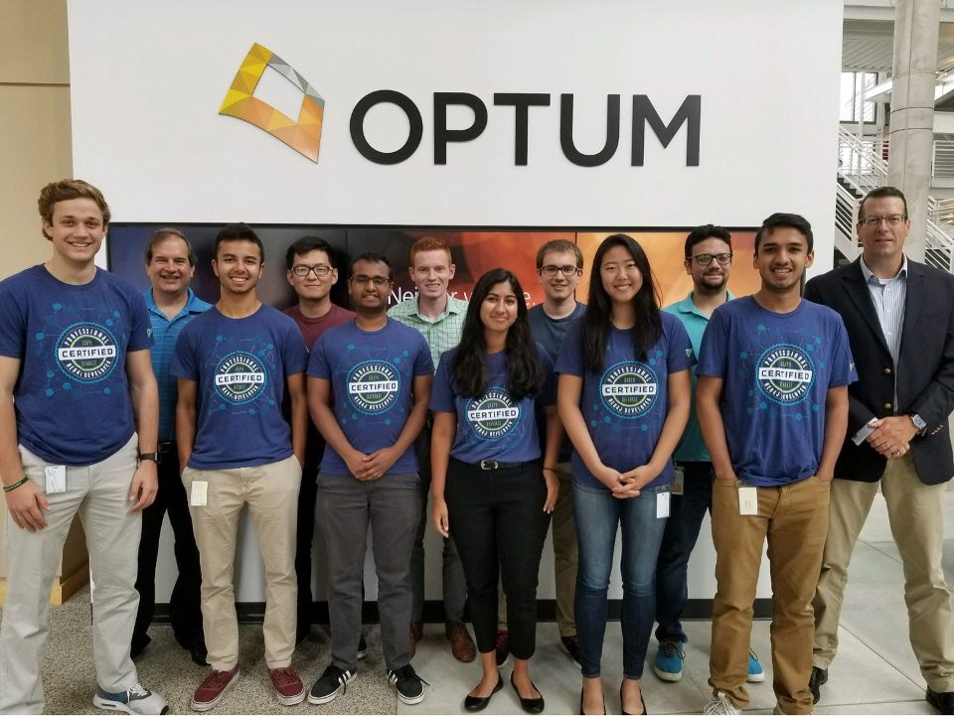
2018 Summer Interns 20+ passed their Neo4j certification exams!

Slide 32
Summary
Healthcare is full of “wicked problems”
Graph databases are a great step in the right direction – but they will not solve the healthcare connection problems alone
We need engineers that have a deep appreciation for graph and…
Natural Language Processing
Machine Learning
Search, semantics and metadata
Graph traversal algorithms
Graph visualization
Distributed systems
High availability
Security
Statistics and causality

Slide 33

Optum Advanced Technology Collaborative
Dan.McCreary@optum.com
https://medium.com/@dmccreary
@dmccreary

Slide 34



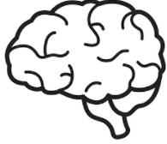

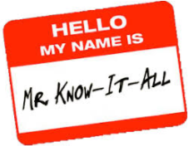

Bias Recognition in Database Selection
The first part of recognizing a bias is to give them names
RDBMS
Newsletter
memory
Anchoring Bias
Availability heuristic
Bandwagon Effect
Confirmation bias
What I Know
World
Framing Effect
Gamblers Fallacy
Hindsight Bias
Halo Effect
Representativeness Heuristic
Notes:
Give Credit to Mary Popendick…

Slide 35
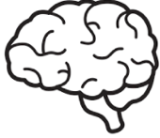


Sample of Database Selection Bias
Anchoring bias - the tendency to produce an estimate near a cue amount - "Our managers were expecting an X solution so that’s what we gave them." Availability heuristic - the tendency to estimate that what is easily remembered is more likely than that which is not. - "I hear that NoSQL does not support ACID." or "I hear that graphs don’t scale”. Bandwagon effect - the tendency to do or believe what others do or believe - "Everyone else at this company and in our local area uses X." Confirmation bias - the tendency to seek out only that information that supports one's preconceptions – "We only read blog posts from the Product X groups." Framing effect - the tendency to react to how information is framed, beyond its factual content "We know of some graph projects that failed."

Slide 36


Bias Continued
Gambler's fallacy (aka sunk cost bias) the failure to reset one's expectations based on one's current situation – "We already paid for our Product X license so why spend more money?" Hindsight bias - the tendency to assess one's previous decisions as more efficacious than they were – "Our last five systems worked on RDBMS solutions". Halo effect - the tendency to attribute unverified capabilities in a person based on an observed capability. – ”Vendor X sells billions of dollars of licenses each year, how could so many people be wrong". Representativeness heuristic - the tendency to judge something as belonging to a class based on a few salient characteristics - "Our accounting systems work on X so why not our product search?"
What I Know
World
Notes:
The six thinking hats: Bono (Arun)

